Slide 1

Theory of narrow-band mode-locking
厦门大学：罗塞雨
导师：蔡志平教授

Slide 2
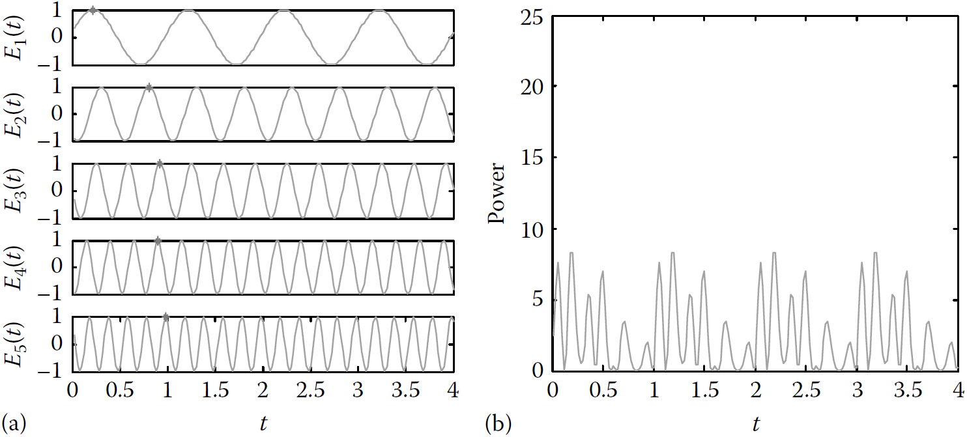
1. Mode-Locking Theory
a laser can oscillate at a number of resonant frequencies whose spacing is equal to the fundamental frequency ω_{R} of the cavity:
The output electric field of the generated lightwave in the temporal domain is the summation of all the oscillating modes given as

Slide 3
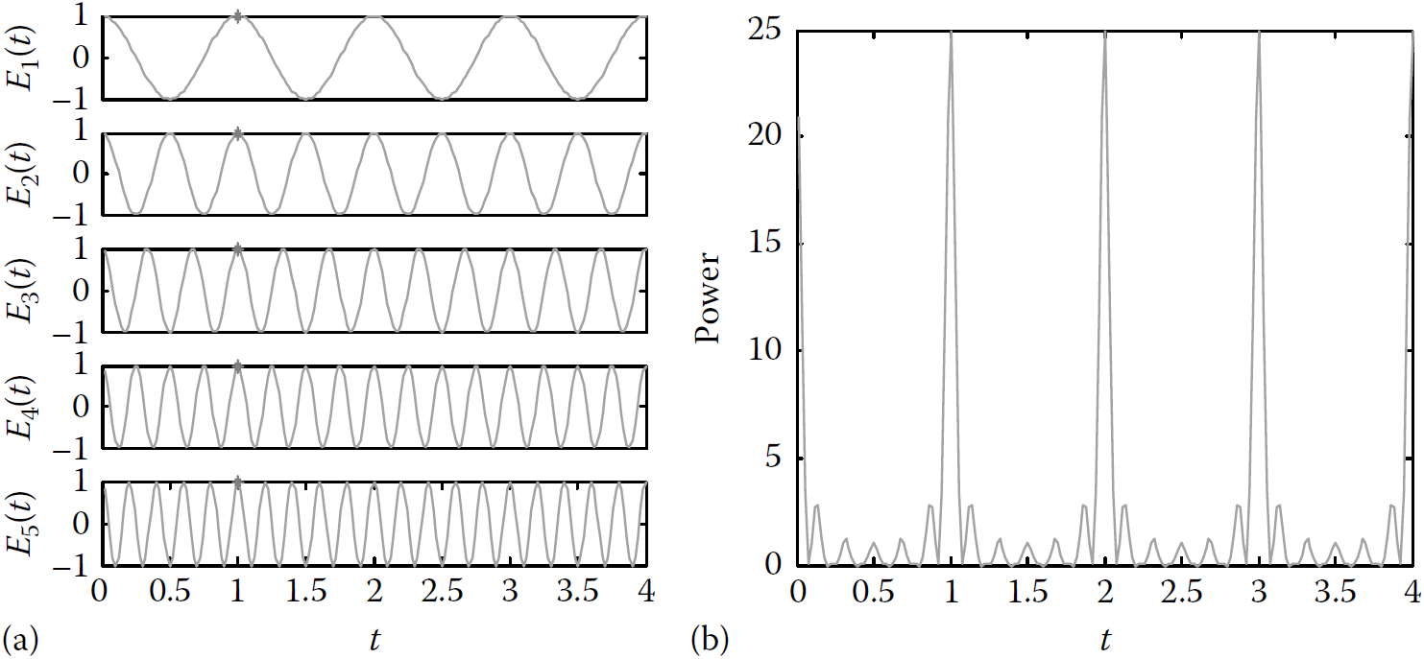
when the modes are forced to lock together, that means all the N modes are either in phase or different in a multiple number of 2π, E_{n}
and Φn will be constants. The simplest case is when E_{n} = 1, and Φ_{n} = 0
which is an oscillation at frequency ω₀ modulated with the sinc envelope function. The average power is thus given by

Slide 4
The periodic train of pulses that have the following properties
the pulse period is T = 2π/ω_{R};
the peak power is N times the average power;
the peak field amplitude is N times the amplitude of a single mode;
the pulse width, defined as the time from the peak to the first zero, is τ =T/N, which shortens as N increases.

Slide 5
2. Mode-Locking Techniques
2.1 Passive Mode Locking

Slide 6
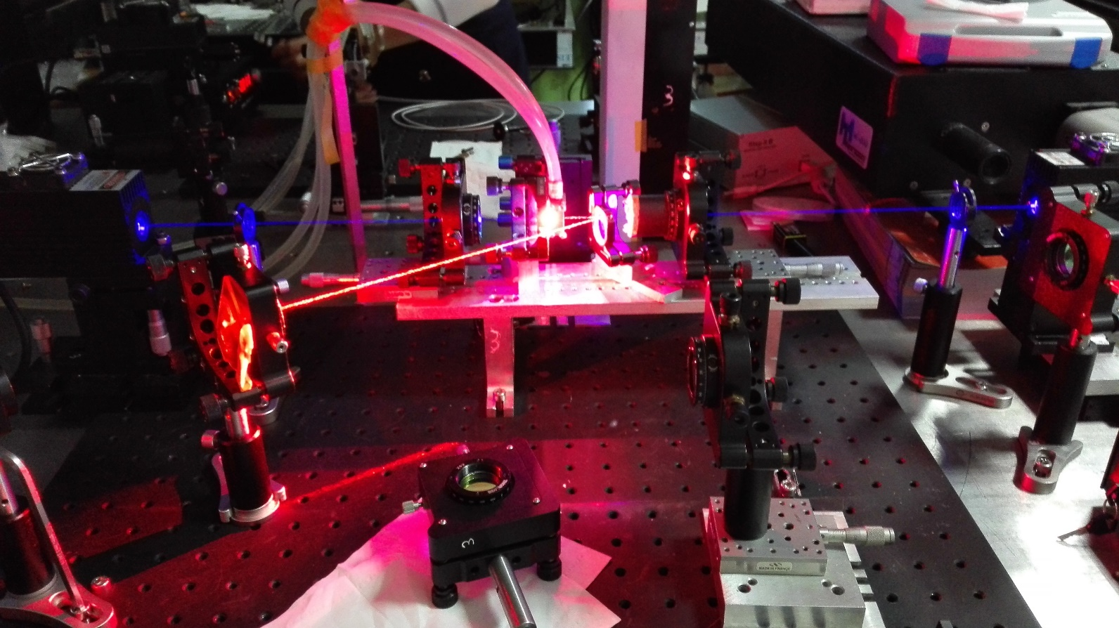
Self-Mode-Locking
0.3 m cavity

Slide 7
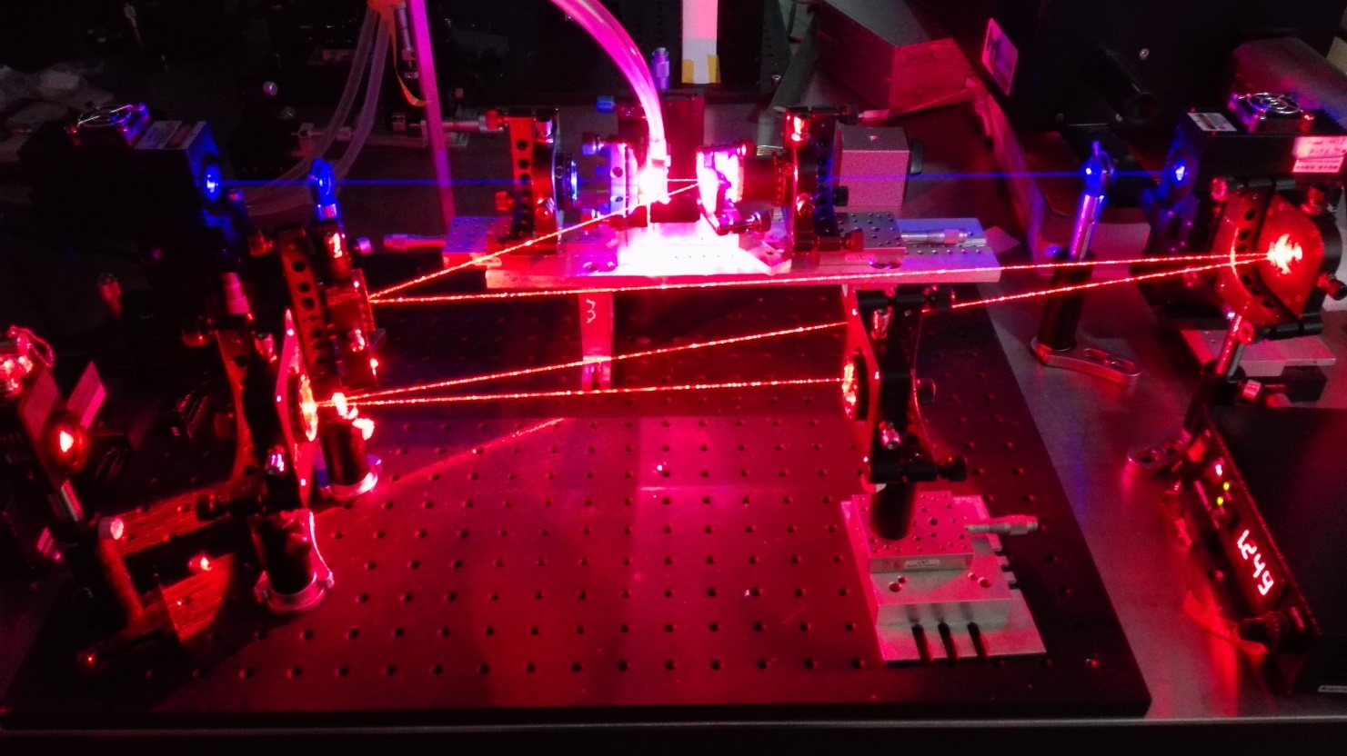
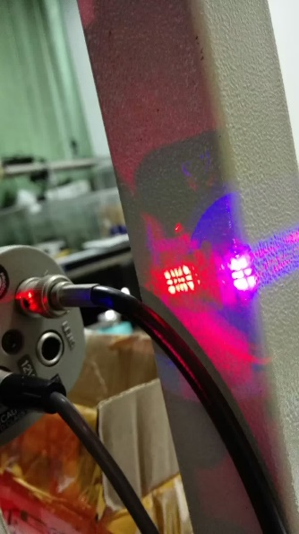
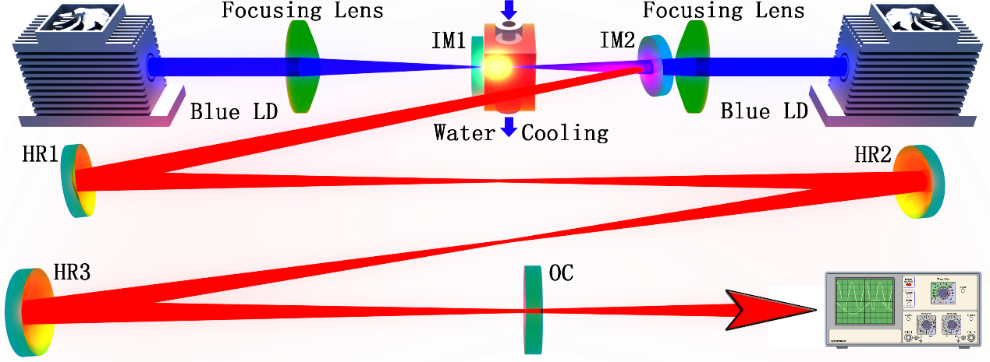
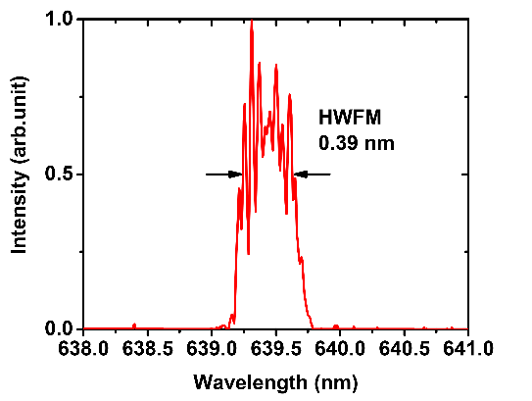
Kerr mode-locking
1.8 m cavity

Slide 8
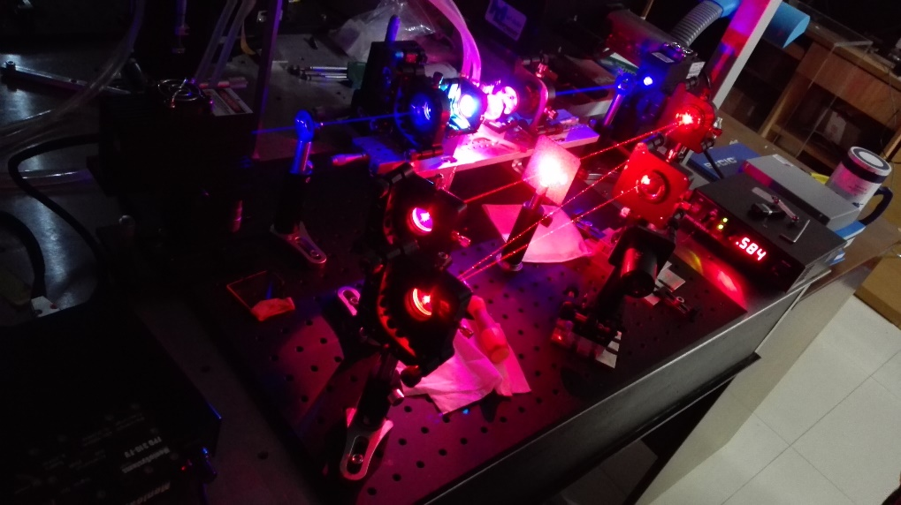
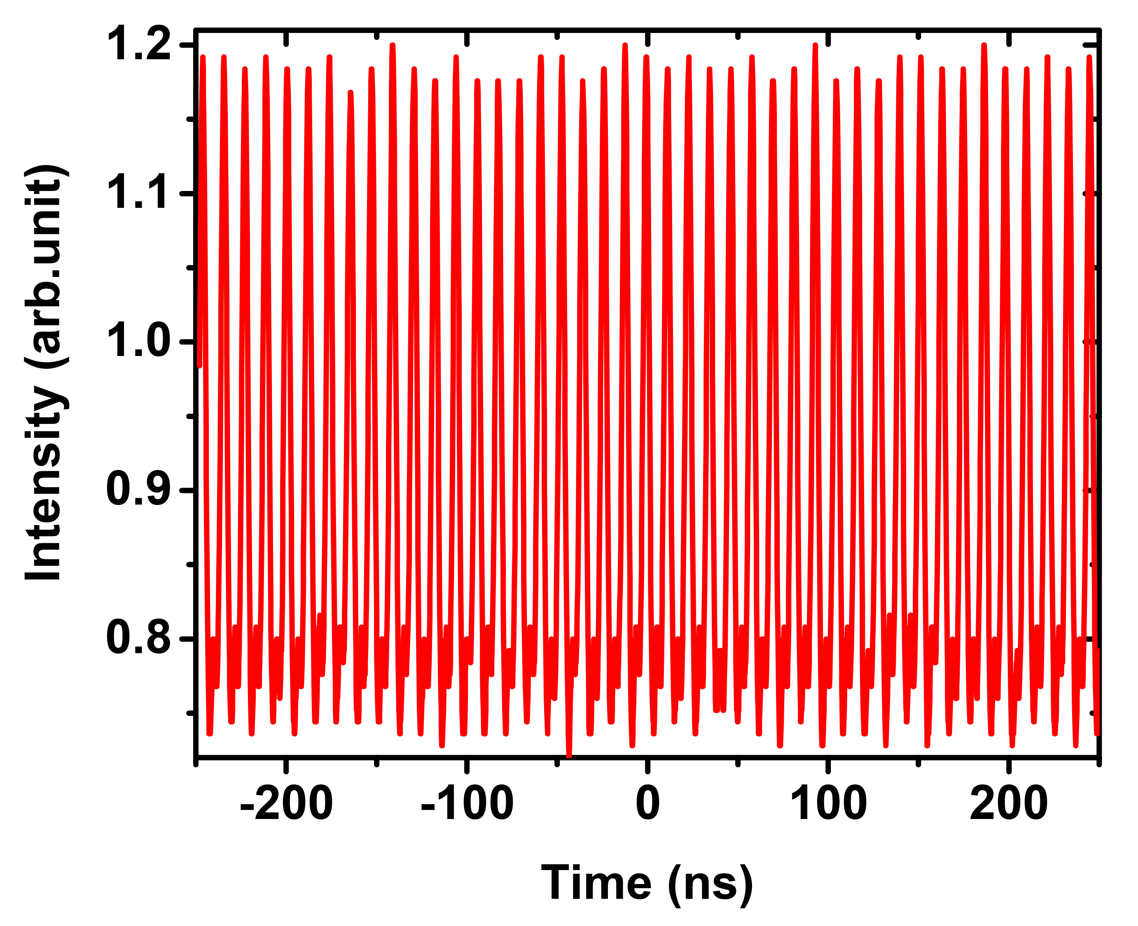

Slide 9
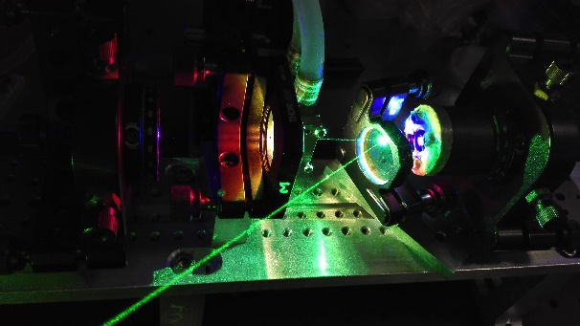
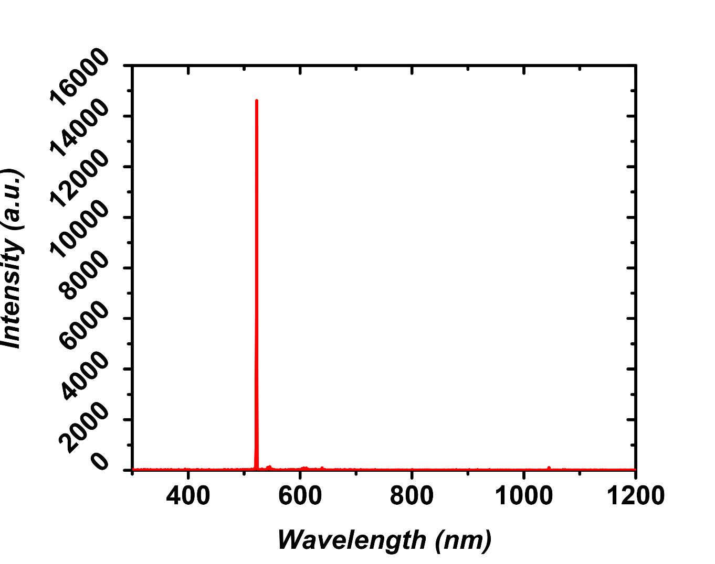
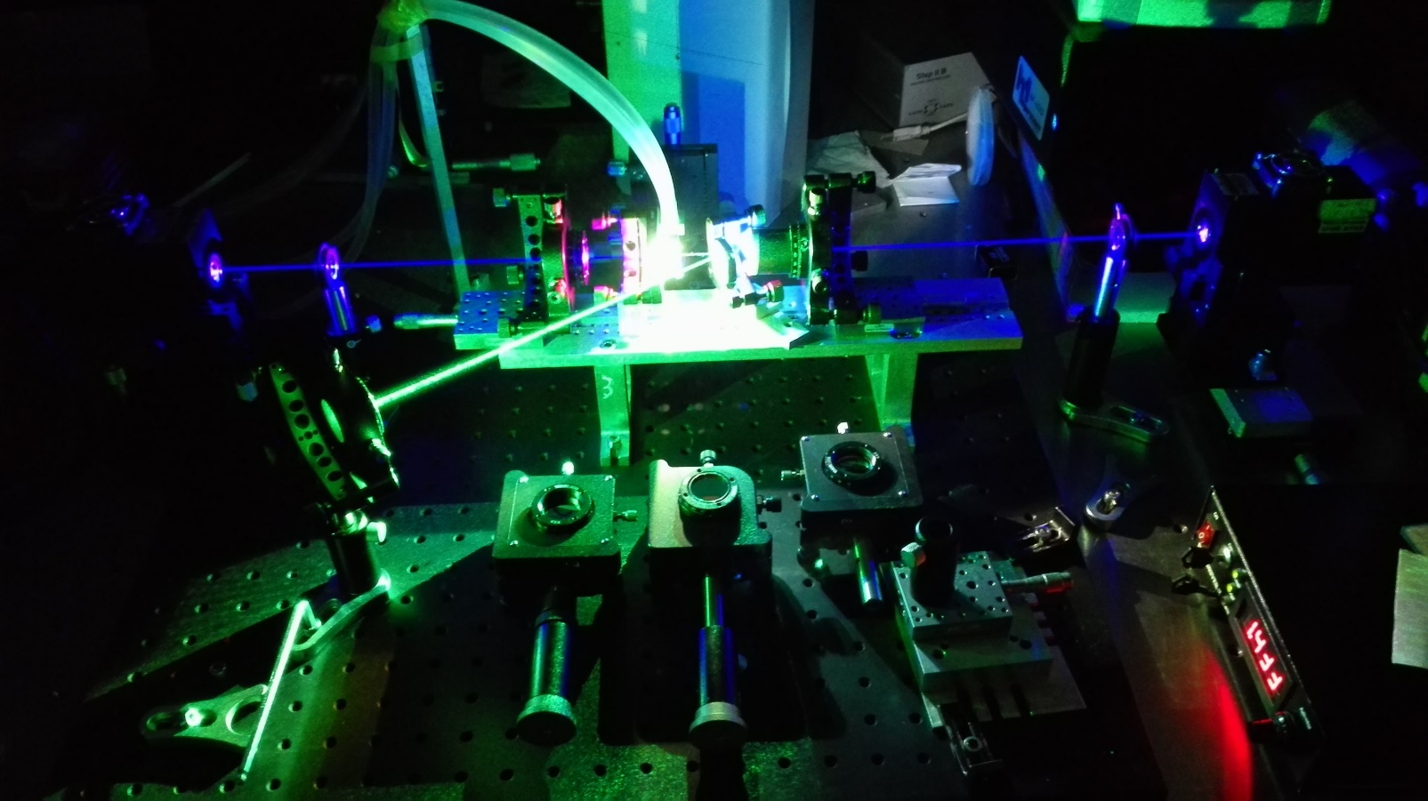
Green Self-mode-locking

Slide 10
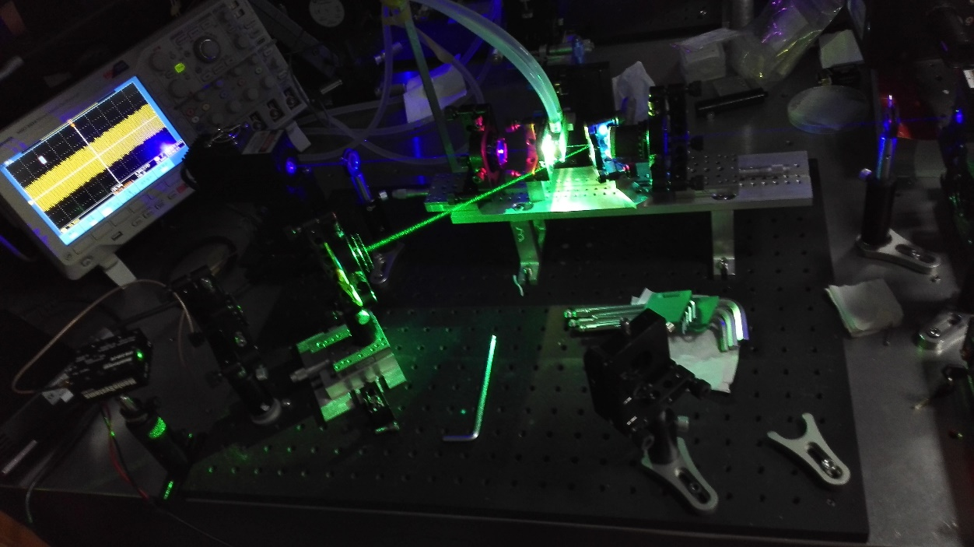
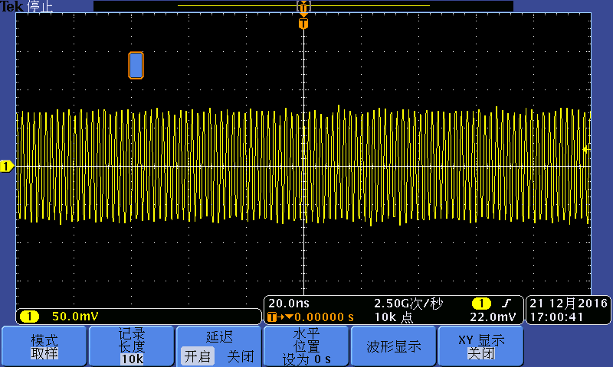
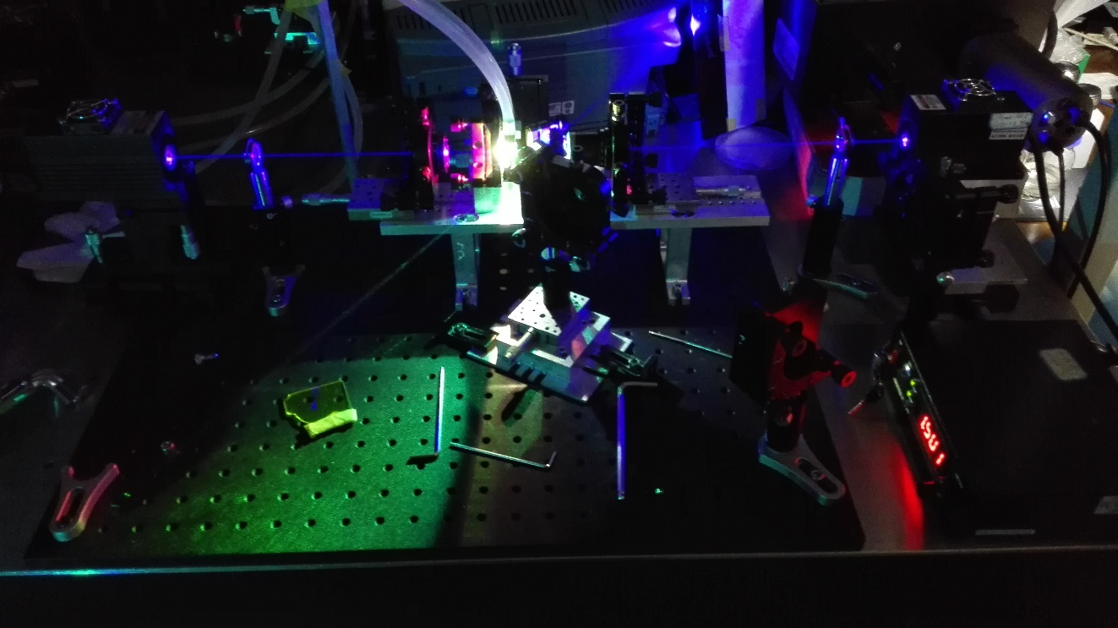
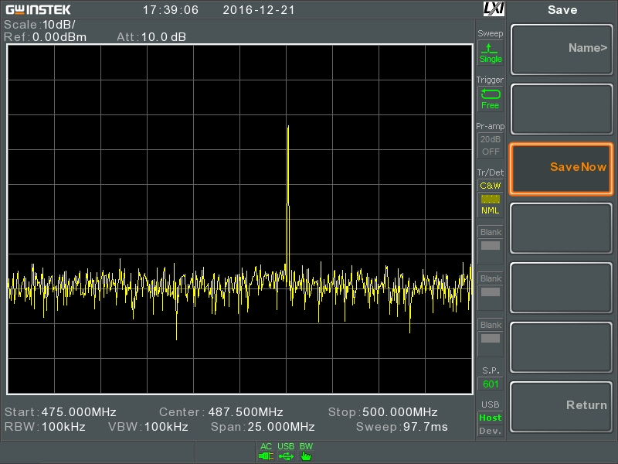

Slide 11
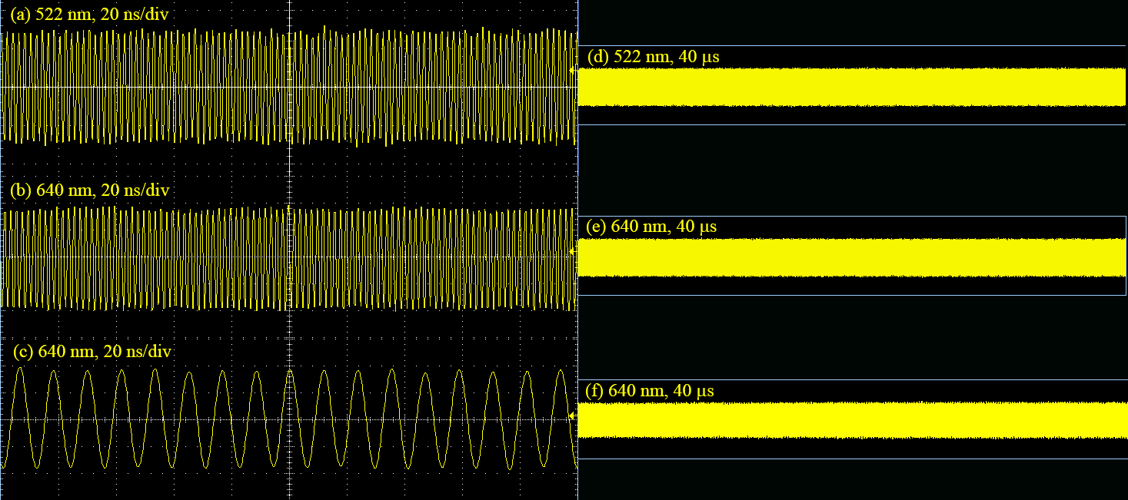

Slide 12
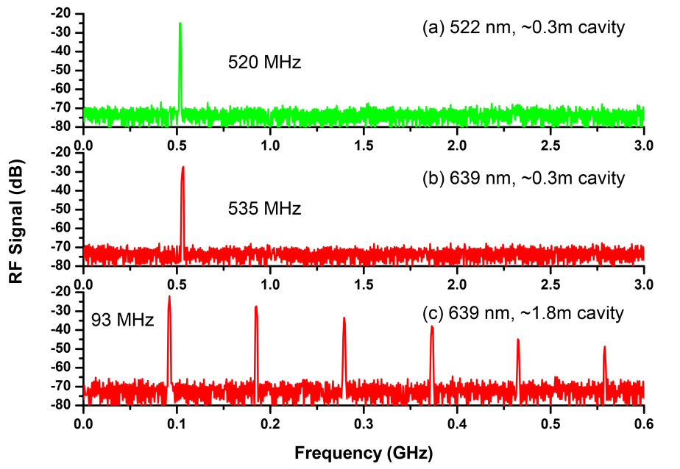

Slide 13

谢谢！

